Slide 1

Best-selling Regions in Edmonton (clustering) – Go Auto)
CMPT 3830
Md Mahbub Mishu

Slide 2
GROUP NAME & MEMBERS
Anmolpreet Kaur: Team Leader
Manages project workflow, leads Exploratory Data Analysis (EDA), and coordinates with instructor/client.
Gurwinder Kaur: Data Preprocessing
Responsible for cleaning and structuring data for analysis
Harinderjeet Singh: Data visualization
Design charts, maps and graphical insight to present
Chahalpreet Singh: ML Model
Implements Machine Learning models and clustering

Slide 3

Problem Statement
Problem:
Go Auto needs to optimize marketing and inventory distribution using clustering of sales data by dealership postal codes in Edmonton.
Focus on clustering sales data to identify distinct regions of interest.
Objective:
Apply machine learning clustering techniques to segment regions.
Optimize Go Auto’s operations based on the clustering insights.

Slide 4
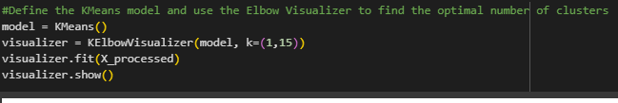
Development and Implementation of the ML Model
Model Used:
KMeans
KMeans Clustering: KMeans is a popular clustering algorithm that groups data into k distinct clusters. This algorithm is well-suited for geographical data as it can identify natural groupings of dealerships
Preprocessing:
Standardized numerical features using StandardScaler.
Encoded categorical variables using LabelEncoder.
Feature Selection: Focus on location, sales, and dealership data.
Clustering:
Determined optimal cluster count using the Elbow Method.

Slide 5
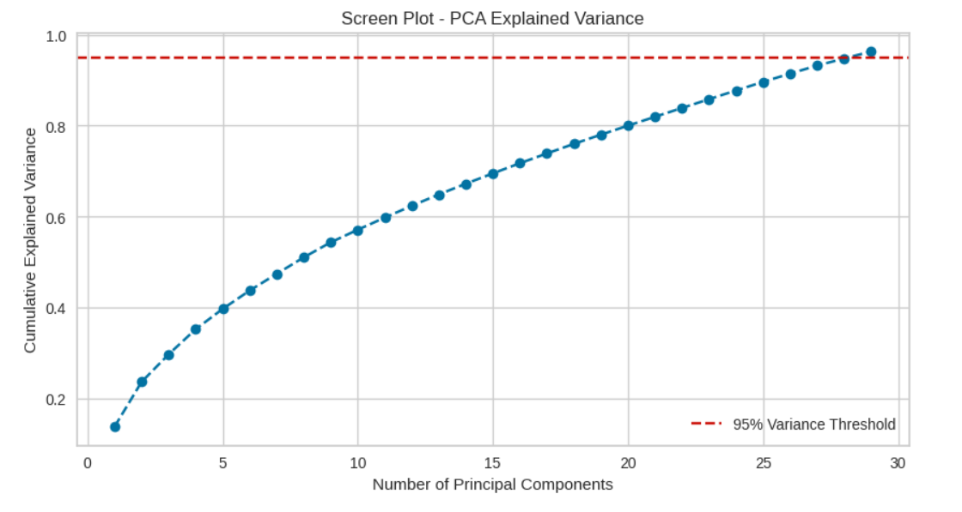
Principal Component Analysis (PCA)
Applied PCA to reduce dimensionality from 6 features to 2 principal components. PCA retained over 90% of the variance, improving clustering efficiency and model performance. PCA helped to:
Remove noise and reduce redundancy.
Improve cluster separation and accuracy.
Reduce model training time and complexity.

Slide 6
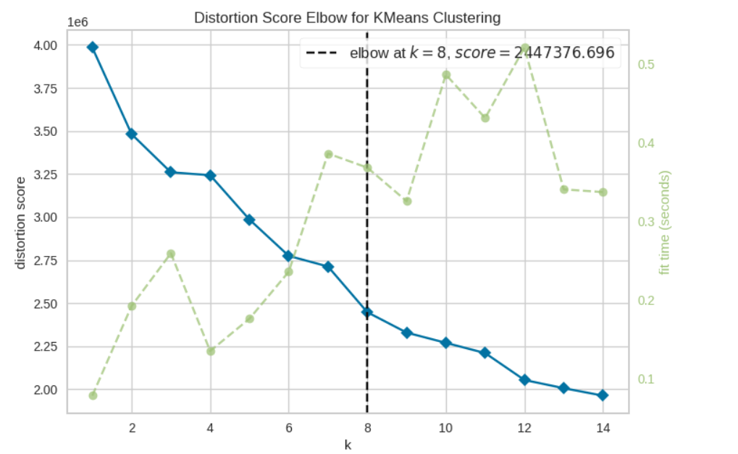
Optimal Cluster Selection
Elbow Visualizer: The elbow method is used to determine the optimal number of clusters by analyzing the inertia (within-cluster sum of squares) for different values of k. The "elbow" point on the plot corresponds to the optimal k, which minimizes inertia without overfitting the model.
elbow plot showing how inertia decreases as the number of clusters increases, with the "elbow" at k=9.

Slide 7
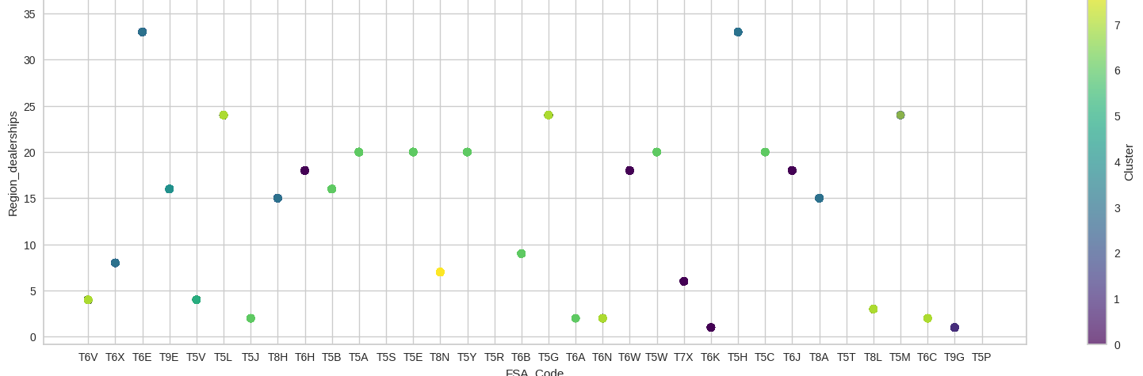
K Means clusterring
KMeans Implementation: Once the optimal number of clusters is determined (k=9), the KMeans algorithm is used to group the data into these 9 clusters.
Cluster Labeling:Each data point is assigned a cluster label, indicating which group it belongs to. Show a scatter plot or another visual representation of how the data points are grouped into 9 clusters based on their features.

Slide 8
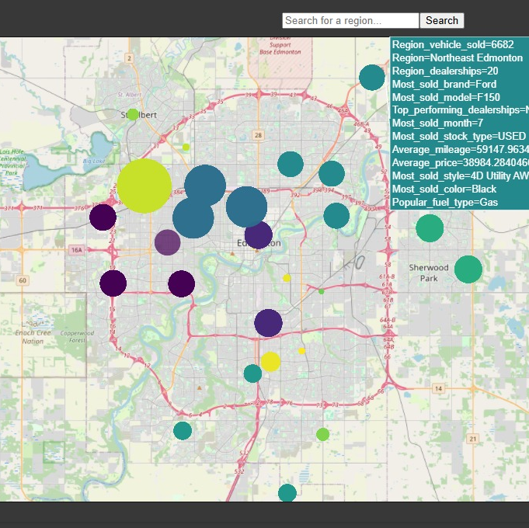
Map
In this Map we visualized the insights from region, based on FSA code we divided regions, such as NorthEast Edmonton, North Edmonton, Central Edmonton, etc. From map we can see that Clusteres are formed in which size represent number of vehicle sold in that region and color represent number od dealership in that regionn . Here we can see that in NorthEast Edmonton vehicle sold were 6682, with 20 dealership and Ford is the most sold brand with model F150, and top performing dealership in that region is NorthGate Cheverlot Buick , most sale is accounterd in July month, and various other insight you can observe from hovering data.

Slide 9
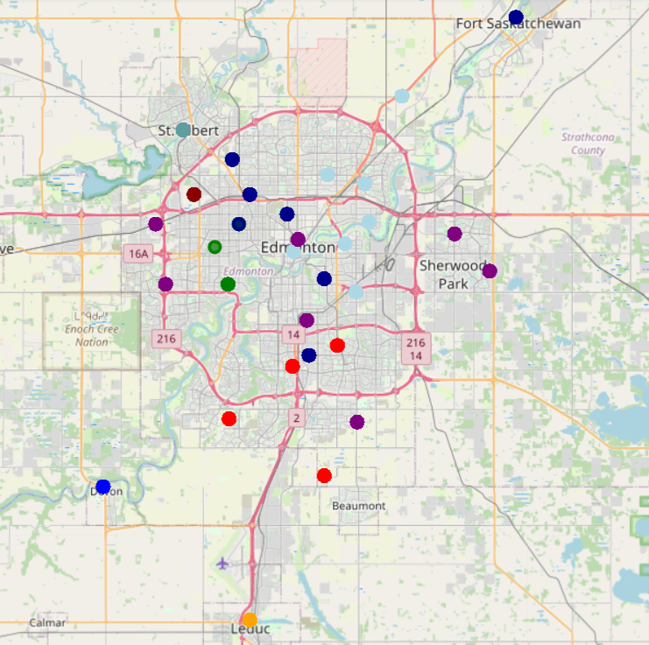
Cluster Visualization
Scatter Plot: A 2D scatter plot of FSA_Code vs Region_dealerships is used to visualize how the clusters are spread out. Color-coding the points by cluster helps highlight the different groups.
Interactive Map (Folium): Map displays the clusters geographically based on latitude and longitude. The map allows for easy identification of how the clusters are geographically distributed. It create or plot the points on the maps on the basis of mean average of latitude and longitude of all delaership belongs to a particular region.

Slide 10
Conclusion
Summary of Findings:
Identified top-performing sales regions in Edmonton is West and South area. By using K means clustering techniques.
Discovered underperforming clusters in North Edmonton.
PCA reduced the dataset's complexity, making clustering more efficient while retaining important variance.
These insights helpful to optimize dealership placement and sales strategy. This allowing for better targeting of high-potential regions and improvement in underperforming areas.

Slide 11
Next Step
Develop a Power BI Dashboard for real-time sales insights.
Test other clustering models like DBSCAN for comparison.
Collect feedback from dealerships to validate cluster insights and adjust strategies
Create an application that helps to integrate the model with input to produce optimal output and excellent performance

Slide 12
Thank you

